Slide 1


Why doesn't it update?
React · Lecture 3
The value changes. The screen doesn't.
let count = 0;
function Counter() {
return (
0
<button onClick={() => count++}>
{count}
</button>
);
}
count = 3
1
Notes:
Run it live. React doesn't know the variable changed, and it would reset anyway.

Slide 2


useState
React · Lecture 3
A value React remembers + a function to change it
setter
const [count, setCount] = useState(0);
current value
starting value
2
Notes:
It's array destructuring. Convention: [thing, setThing].

Slide 3
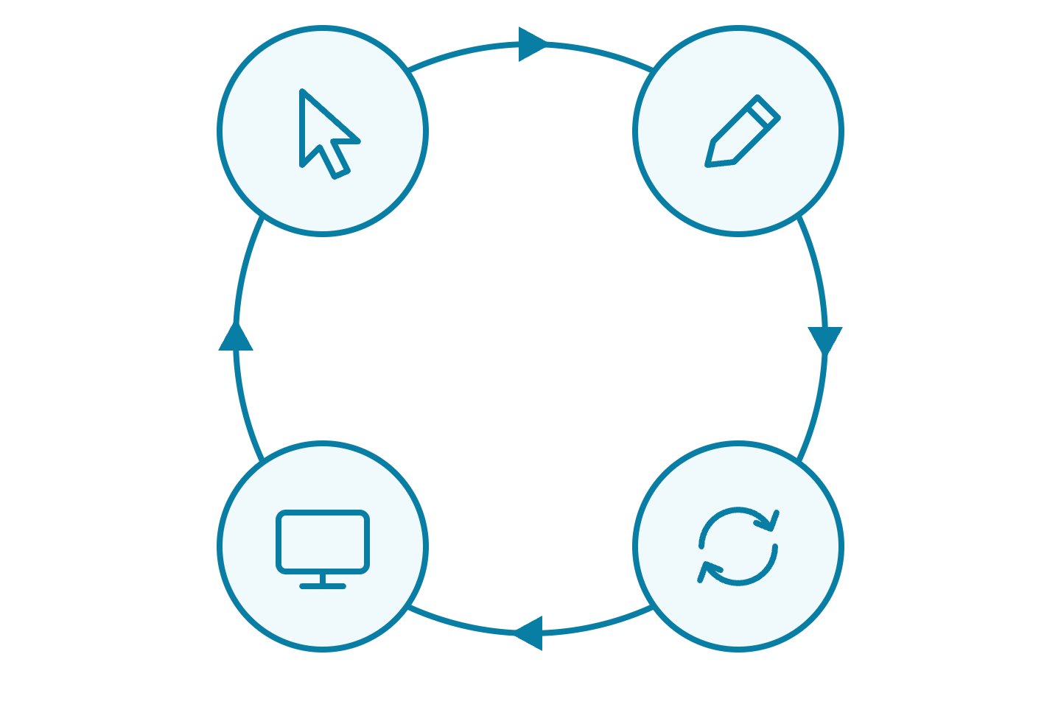
The update loop
React · Lecture 3
Click → setState → re-render → new screen
1 Click
2 setState
4 new screen
3 re-render
3
Notes:
Every interactive feature follows this loop.

Slide 4
Handling events
React · Lecture 3
Like addEventListener, written in JSX
function handleClick() {
setCount(count + 1);
}
<button onClick={handleClick}>+1</button>
4
Notes:
The event object e works as in vanilla JS.

Slide 5
Pass it, don't call it
React · Lecture 3
✘
runs on every render
✔
runs on click
onClick={handleClick()}
onClick={handleClick}
// to pass an argument
onClick={() => remove(id)}
5
Notes:
The ✘ version runs while rendering. Show the infinite-loop error.

Slide 6


Controlled input
React · Lecture 3
React holds the input's value
<input>
const [text, setText] = useState('');
milk
<input
onChange
value
value={text}
onChange={e => setText(e.target.value)}
text: "milk"
/>
state
6
Notes:
One source of truth: the input shows what state says.

Slide 7

Never mutate state
React · Lecture 3
Make a new array. Don't change the old one.
✘
✔
items.push(newItem);
setItems(
setItems(items);
[...items, newItem]
);
7
Notes:
Same array → React thinks nothing changed.

Slide 8
Add, remove, update
React · Lecture 3
Add
setItems([...items, newItem])
Remove
setItems(items.filter(i => i.id !== id))
setItems(items.map(i =>
Update
i.id === id ? { ...i, done: !i.done } : i
))
8
Notes:
These three patterns cover almost every list.

Slide 9
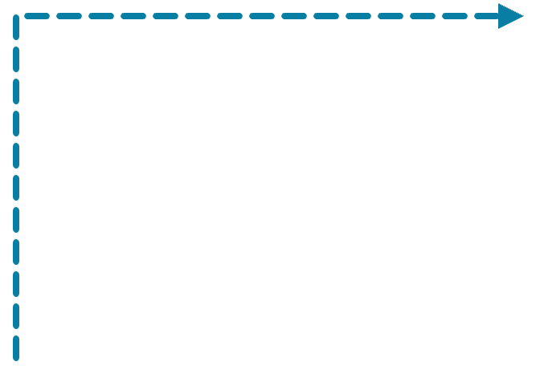


Lifting state up
React · Lecture 3
Shared data lives in the closest common parent
Parent
state
search
SearchBar
ProductList
gets
setSearch
gets
search
9
Notes:
Find the closest parent of everyone who needs the data.

Slide 10
Props vs state
React · Lecture 3
Props | State
comes from the parent | owned by the component
read-only | changed with its setter
like function arguments | like the component's memory
10
Notes:
The same data can be state in a parent and a prop in a child.

Slide 11

Homework
React · Lecture 3
Shopping list
Add an item with quantity
Remove an item
Mark as bought
Show how many are left
11

